Slide 1

Alpha Assistant
Personal voice assistant.

Slide 2

PROJECT MEMBERS
SAMARTH MATH SEAT NO.
RAHUL JAIN SEAT NO.

Slide 3

INTRODUCTION
The project aims to develop a personal assistant for windows system. Alpha assistant draws its inspiration from virtual assistants like Cortana for windows, and Siri for iOS.
A personal assistant, Alpha assistant is designed to assist the user and for carrying out day to day activities such as searching queries, searching on Wikipedia, playing songs, sending emails, general human conversation and many other tasks.

Slide 4
PROBLEM STATEMENT
The voice assistant is design to make the work easier of the user. The biggest disadvantage of this system is that confidential data can be accessed by unauthorized user so the privacy can be breached. Due tot his, the confidentiality, integrity and availability (CIA) of user data is affected.
Looking to this problem the security features of our assistant is the main priority which is that we have made a personal customized assistant which doesn't track your activities. it can become accessible to the mass market-to both law enforcement and private consumers.

Slide 5
PURPOSE OF THE SYSTEM
The main purpose of an intelligent virtual assistant is to answer questions that users may have. It will be capable to perform general interactions, searching topics on the Wikipedia, send emails, play songs, and many more tasks.
Virtual assistants can tremendously save you time. We spend hours in online research and then making the report in our terms of understanding. Alpha assistant can do that for you. Provide a topic for research and continue with your tasks while Alpha does the research.

Slide 6
EXSISTING SYSTEM:
The existing systems available like Cortona and Alexa
Are very much costly. They are not available at the affordable price for many people.
We already have multiple virtual assistants. But we hardly use it. There are number of people who have issues in voice recognition. These systems can understand English phrases but they fail to recognize in our accent. Our way of pronunciation is way distinct from theirs. Also, they are easy to use on mobile devices than desktop systems. There is need of a virtual assistant that can understand English in Indian accent and work on desktop system

Slide 7
SCOPE :
Presently, Alpha is being developed as an virtual assistant. Among the Various roles played by Alpha are:
Search Engine with voice interactions2.
Play Music, Open YouTube 3.
Tell Jokes.4.
tells Time And Date.5.
Replies How Are You.
6. Reads Information From Wikipedia.

Slide 8
HARDWARE AND SOFTWARE REQUIREMENTS:
The software is designed to be light weighted so that it does not be a burden on the machine running it. This system is being build keeping in mind the generally available hardware and software compatibility. Here are the minimum hardware and software requirement for virtual assistant.
Hardware:
• Pentium-pro processor or later.
• RAM 512MB or more.
Software:
• Windows 7(32-bit) or above.
• Python Version 3
• Tkinter

Slide 9
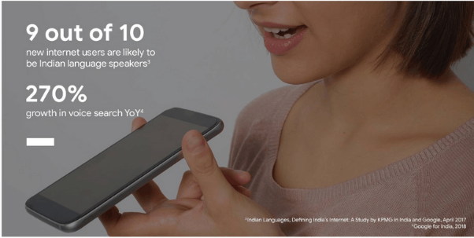

Slide 10
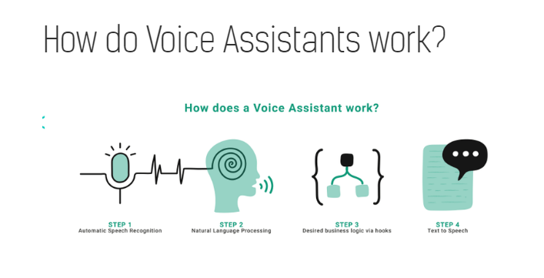

Slide 11
INPUT:

Slide 12
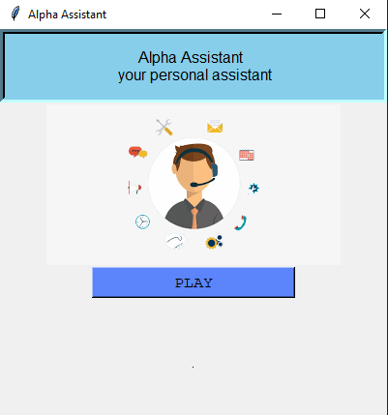
OUTPUT SCREEN:

Slide 13
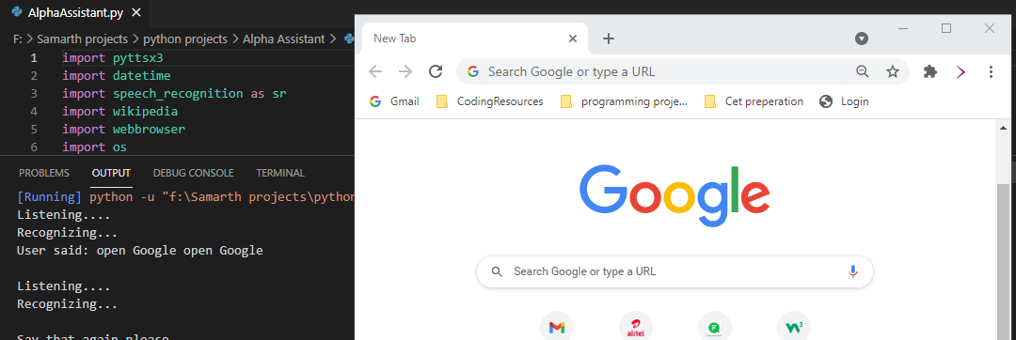

Slide 14
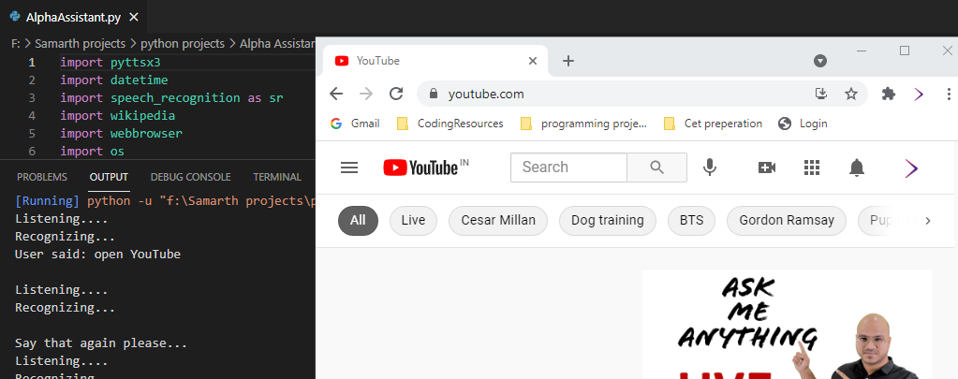

Slide 15
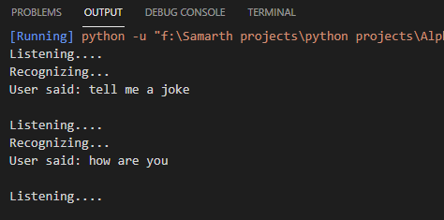
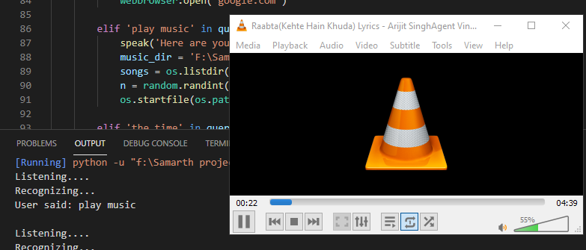

Slide 16
ER DIAGRAM
OPEN YOUTUBE
OPEN
GOOGLE
MICHRO
PHONE
USER
PLAY
MUSIC
PERFORM
ACTION
SEARCH WIKIPEDIA

Slide 17
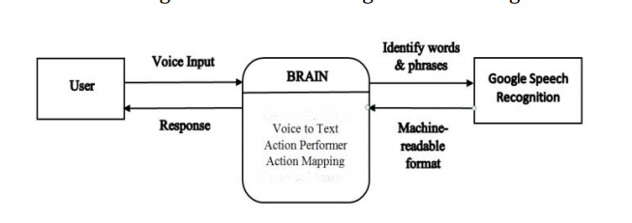
DATA FLOW DIAGRAM
LEVEL 0 :

Slide 18
Future of Voice Assistants:
Advancements in Artificial Intelligence and Machine Learning are truly revolutionizing how we use voice assistants in our daily lives
With voice now establishing itself as an ultimate mobile experience, businesses are only beginning to understand how they can integrate voice in all their activities. A recent report by PwC reveals that the adoption of voice assistant technology is highest among 18-24-year-olds. But the group that uses voice assistants most frequently is the 25-49-year-old group.

Slide 19
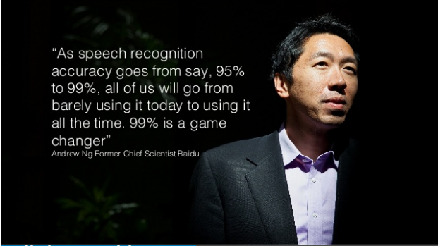

Slide 20


